Slide 1
Heart Disease Diagnostic Analytics
By – v h nidhi

Slide 2
Introduction
Cardiovascular diseases have consistently been the leading cause of death globally over recent decades, affecting both developed and developing countries. The early detection of cardiac conditions and continuous monitoring by healthcare professionals can significantly reduce mortality rates. However, it is impractical to monitor patients accurately around the clock, and 24-hour patient consultation by a doctor is not feasible due to the required levels of knowledge, time, and expertise.
The goal of this project is to analyze the heart disease occurrence, based on a combination of features that describes the heart disease

Slide 3
Dataset Column Description
age: The person's age in years
sex: The person's sex (1 = male, 0 = female)
cp: The chest pain experienced (Value 1: typical angina, Value 2: atypical angina, Value 3: non-anginal pain, Value 4: asymptomatic)
trestbps: The person's resting blood pressure (mm Hg on admission to the hospital)
chol: The person's cholesterol measurement in mg/dl
fbs: The person's fasting blood sugar (> 120 mg/dl, 1 = true; 0 = false)
restecg: Resting electrocardiographic measurement (0 = normal, 1 = having ST-T wave abnormality, 2 = showing probable or definite left ventricular hypertrophy by Estes' criteria)
thalach: The person's maximum heart rate achieved
exang: Exercise-induced angina (1 = yes; 0 = no)
oldpeak: ST depression induced by exercise relative to rest slope: the slope of the peak exercise ST segment (Value 1: upsloping, Value 2: flat, Value 3: downsloping)
ca: The number of major vessels (0-3)
thal: A blood disorder called thalassemia (3 = normal; 6 = fixed defect; 7 = reversible defect)
num: Heart disease (0 = no, 1 = yes)

Slide 4




Tools used in this Project

Slide 5
Architecture
Data Collection
Importing libraries in Jupyter Notebook and loading dataset
Data cleaning process
Exploratory Data Analysis
Creating dashboard using Power BI

Slide 6
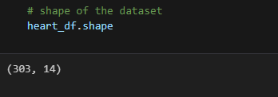
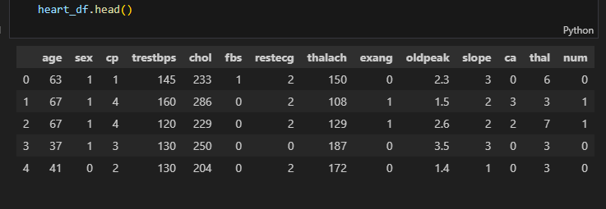
Data Understanding
After loading the dataset into the Python program, we confirm that the data has been loaded correctly by printing the first few rows.
The size of the dataset is 303rows and 14 columns

Slide 7
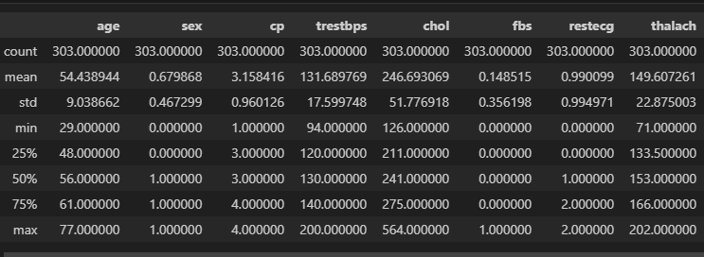
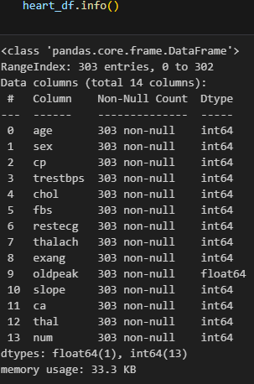
Data overview
Based on this summary we conduct further analysis

Slide 8
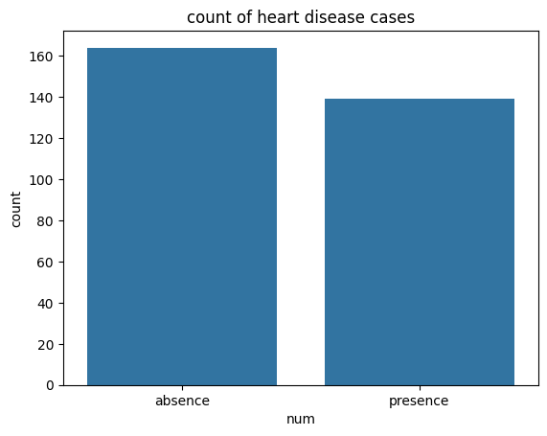
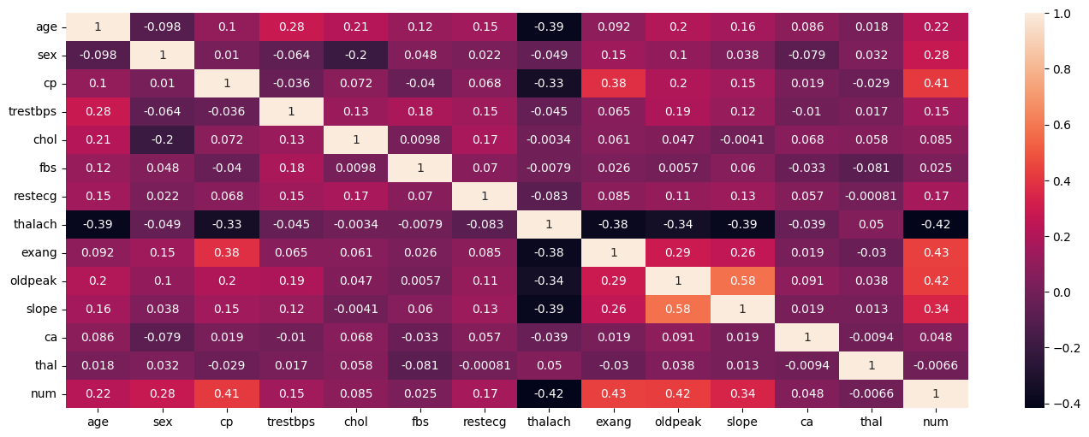
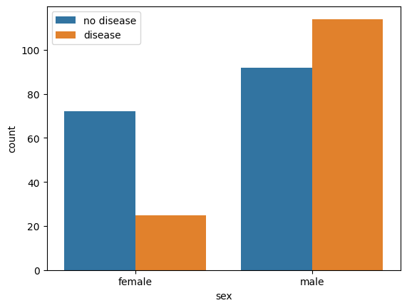
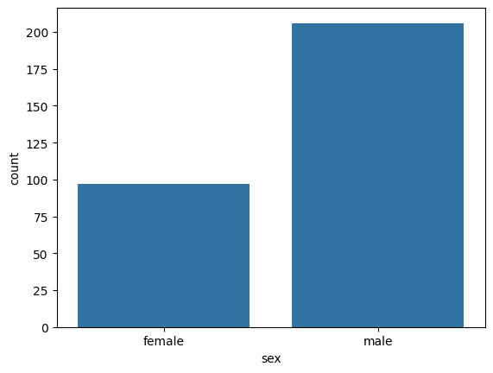
Exploratory Data Analysis
Correlation Matrix
This count plot shows the total absence and presence of heart disease cases.
This count plot indicates a higher number of heart disease cases registered in males.
This count plot shows the heart disease presence and absence in male and female

Slide 9
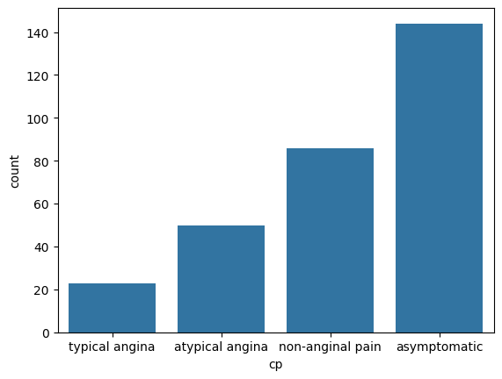
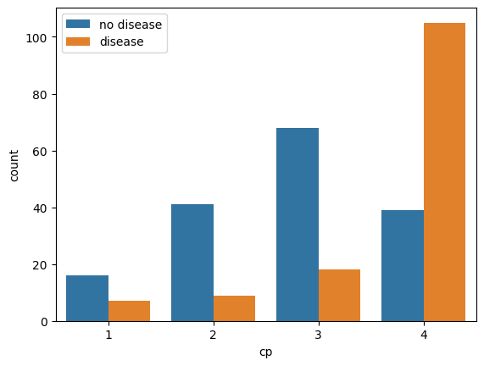
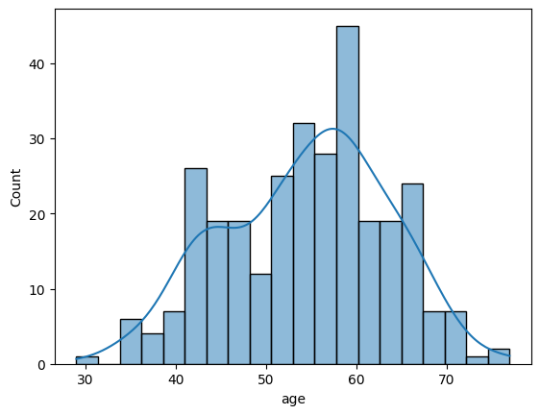
Exploratory Data Analysis
These count plots show the different types of chest paint This chart shows the Age distribution

Slide 10
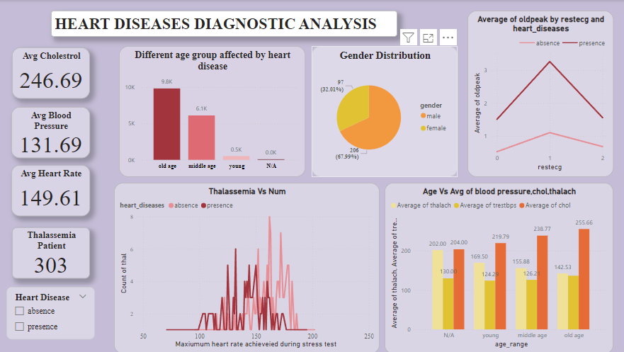
My Dashboard Design

Slide 11
Conclusion
45.87% of People suffering from heart disease.
Males are more prone to heart disease.
Elderly People are more prone to heart disease.
People having asymptomatic chest pain have a higher chance of heart disease.
High cholesterol level in people having heart disease.
ST depression mostly increases between the age group of 30-40.

Slide 12
THANK YOU
BY-V H NIDHI

